Slide 1
PanAmerica Supply, Inc.
Home
About Us
Customer
Line Card
Product
Sales
Contact Us
Welcome
PanAmerica Supply, Inc. (PASI) is a global electrical equipment supplier who provides quality products and support to companies all across the Americas. Our vision is to have customers better understand the reliability of South Korean electrical equipment, and for them to experience this dependability at a competitive offering and with attentive service.
Here on our comprehensive information website, you will find all of your answers regarding our electrical equipment: whether you are developing a new project, checking out product specs, or looking for a reliable business partner. Thank you for your interest, and we look forward to working together with you soon.
Copyright © 2012 by PanAmerica Supply, Inc.

Slide 2
PanAmerica Supply, Inc.
Home
About Us
Customer
Line Card
Product
Sales
Contact Us
Company History
In 2005, PanAmerica Supply, Inc. (PASI) was established in Houston, Texas by Shaun Choi because of the increased demand for high quality South Korean electrical products in the North American markets. Shaun Choi had worked in the electrical industry for over 20 years and recognized the growing appeal of Korean electrical equipment in the Americas.
Since its establishment, the firm belief behind PanAmerica Supply has always been to provide excellent, reliable equipment at a competitive value while maintaining superb technical support and after-service. We always strive to exceed customer expectations.
After a strong focus on the electrical industry for several years—mainly working with power transformers and cables—PanAmerica Supply decided to further serve the power needs of American markets by expanding its product lines and working with other power-related industries. PASI now supports oil & gas, renewable power, mining, wind turbine manufacturing, and chemical industries by supplying qualified power-related goods. Even with its expansion, PanAmerica Supply, Inc. always maintains its stance behind high quality equipment and individualized service to this day.
Who We Are
PanAmerica Supply, Inc. (PASI) offers global distribution services accompanied with valuable technical and maintenance support desired by our clients. Our goal is to work with customers long term and continue to care for each project well after the purchase order and delivery is made. We coordinate with our South Korean manufacturers to fit the criteria of each project and attentively address any client concerns or questions.
With power-related equipment ranging all the way from huge power transformers to anti-loose locknut innovations, PASI products are perfect for all your power supply needs.
PanAmerica Supply staff have used their education, knowledge, and experience to stay at the front edge in meeting customer’s needs. The strength of our staff comes from various areas, ranging from commercial professionals to engineers to thoroughly trained IT personnel that continue to update our internal systems to perform more efficiently.
PanAmerica Supply, Inc. covers North, Central, and South America and the Caribbean Islands with ever-growing sales efforts. Our ability to coordinate with customers and manufacturers saves everyone time and money. PanAmerica Supply, Inc. is determined to make our vision come true by satisfying American customers with excellent power equipment.

Slide 3
Philosophy
MISSION: The mission of PanAmerica Supply, Inc. (PASI) is to exceed the expectations of customers by providing reliable equipment at a competitive price with faster delivery and better service.
COMMITMENT TO CUSTOMERS: PanAmerica Supply, Inc. is strongly committed to our customers. PASI recognizes that all power-related industries have high demand for reliable electrical equipment and cannot afford to deal with problematic ones. PASI is dedicated to providing only the highest quality products and ensures its commitment to each customer for years down the road through long-term support and attention.
BUILDING STRONG RELATIONSHIPS: PanAmerica Supply, Inc. understands that strong relationships are the key to any business. We build and maintain excellent relationships with both our customers and manufacturers in order to provide the very best electrical equipment distribution. PASI will always be there to assist our business partners.
DEDICATION TO ETHICS: PanAmerica Supply, Inc. is dedicated to maintaining the highest standards of ethical behavior. We operate with corporate responsibility and only work with ethical customers and manufacturers. We also firmly believe in equality and do not discriminate on the basis of age, color, disability, gender, national origin, race, religion, sexual orientation, or veteran status. We are proponents of social responsibility and give back to our communities annually.
News & Events
* Kevin went to vacation from Thursday, August 9th until Tuesday, August 14th. He did not brought any present at all.
* Jane went to vacation to see Tarzan on Friday and she came back on Wednesday, August 15th.
* Kenny drank too much beer on Monday night and he had hung over on Tuesday morning.
* PASI attend the world Vision funding program to raise fund for the cancer society.
Nice Picture Insert
Copyright © 2012 by PanAmerica Supply, Inc.

Slide 4
PanAmerica Supply, Inc.
Home | About Us | Customer | Linecard | Product | Sales Network | Contact Us
Utility
And More…
EPC & Engineering

Slide 5
And More…
Oil & Gas
Renewable
Copyright © 2012 by PanAmerica Supply, Inc.

Slide 6
PanAmerica Supply, Inc.
Home | About Us | Customer | Linecard | Product | Sales Network | Contact Us
Linecard
• Transformers
• Switchgears
• BUS Duct Systems
• Circuit Breakers
• Electrical Equipment
• Transformers
• Transformers
• Capacitors
• Cables
• Cables
• Cables
• Cables
• Termination & Joint
• Dummy Plug & Coupling
• Saper Lock
• Solar Product
• Electric Conponent
Copyright © 2012 by PanAmerica Supply, Inc.

Slide 7
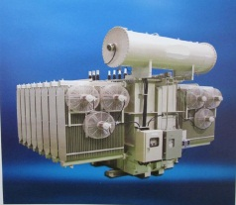
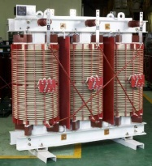
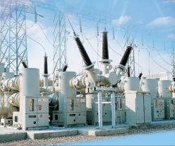
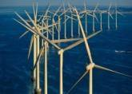
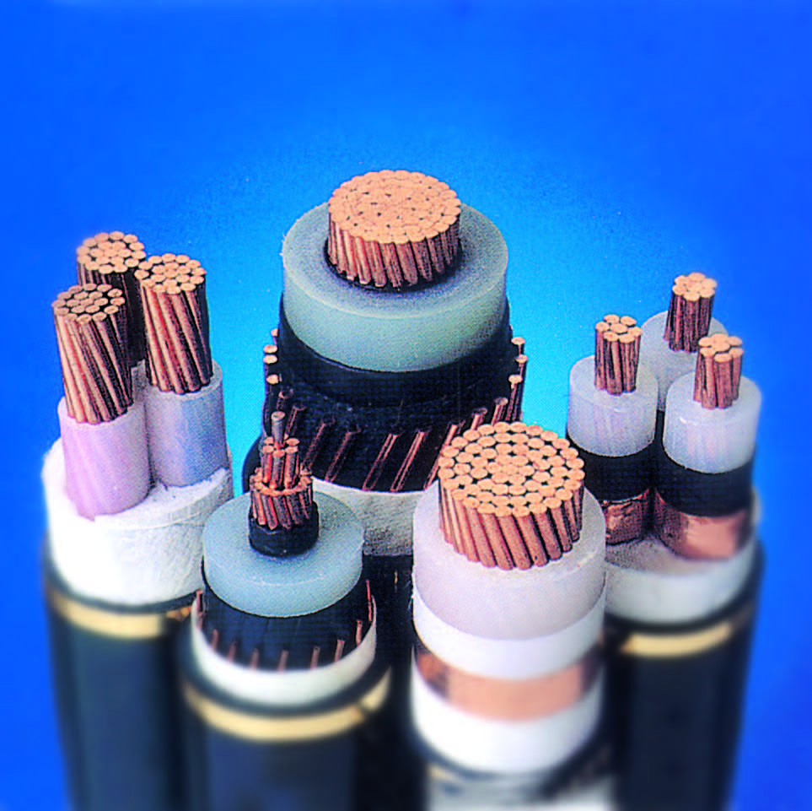
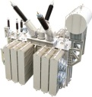
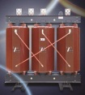
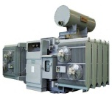
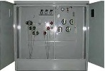
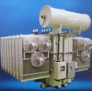
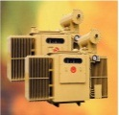
PanAmerica Supply, Inc.
Home
About Us
Customer
Line Card
Product
Sales
Contact Us
TR & Switchgear
Cable
Bus Duct, LED & UPS
Anti-loose Lock Nut
Large Type Transformer
HV Power Transformers 115KV – 500KV 800MVA
Oil Immersed Transformer Uo to 35KV 20 MVA
Cast Rasin / Coil Transformer Up to 35KV 20MVA
Catalog
Catalog
Catalog
Smaller Type Transformer
Catalog
Power Transformer Up to 69KV 50 MVA
Cast Resin / Coil Transformer Up to 35KV 10MVA
Pad Mount Transformer Up to 35KV 3MVA
Catalog
Power Transformer Up to 69KV 50MVA
Cast Resin / Coil Transformer Up to 35KV 10MVA
Pad Mount Transformer Up to 35KV 3MVA
Catalog
Catalog
Switchgear
Gas Insulated Switchgear (GIS) Up to 345KV
Metal Clad Switchgear Up[to 35KV
Catalog
Catalog

Slide 8
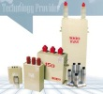
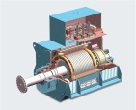
Capacitor
HV / LV Power Capacitor, Capacitor Bank, Harmonic Capacitor Bank, SVC, Special Capacitor and Reactor
Catalog
Catalog
Generator & Motor
LV Speed Generator Up to 600V, LV Generator Up to 1KV, HV Generator Up to 13.8KV
Automatic Voltage Regulator (AVR) Analog/Digital
Catalog
Marine Use Generator
Catalog
Three Phase High Voltage Synchronous Generator
Catalog
HV Generator
Three Phase Synchronous Alternator
Catalog
Synchronous Alternator
Copyright © 2012 by PanAmerica Supply, Inc.

Slide 9
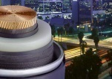
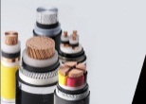
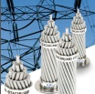
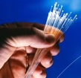
PanAmerica Supply, Inc.
Home | About Us | Customer | Linecard | Product | Sales Network | Contact Us
TR & Switchgear
Cable
Bus Duct, LED & UPS
Anti-loose Lock Nut
** Click image to enlarge
High Voltage XLPE Cable
66~500KV XLPE Cable & Accessories, terminations, joints and other related products
Catalog
EHV
Midium and Low Voltage XLPE Cable
0.6/1kV~18/30kV According to IEC 60502, 61034, 60754
Catalog
MV-LV
HCC Overhead Transmission Cable
High Temperature & Low Sag Aluminum Alloy Conductor
Catalog
TACSR
Offshore and Marine Cable
• Power Distribution Cable 0.6-1KV, 2KV • Control Cable 0.6/1KV
• Signal Cable 0.6/1KV • High Voltage Power Cable 5KV, 8KV, 15KV
Catalog
Offshore & Marine
Optical Ground Wire (OPGW) High-Corrosion Resistant Wire.
Aluminum Loose Tube / Plastic Loose Tube Type, Stainless - Steel Loose Tube Type
Catalog
OPGW
Wind Turbine Cable. XLPE HV Power Cable, XLPE Insulated, Copper/Aluminum Conductor, 12/20kV, 18/30kV Onshore, XLPE Insulated, Copper/Aluminum Conductor, 12/20kV, 18/30kV, XLPE Insulated, ~ 45kV Offshore, XLPE Insulated, 66kV ~ 500kV Onshore, XLPE Insulated, 66 ~ 500kV Offshore, Mass-Impregnated, DC ±250kV Offshore
Catalog
Wind Turbine
Non Zero Dispersion Shifted Optical Fiber, Multi Mode Fiber, High Speed Local Network
Catalog
Fiber Optic
LAN Cable, Jacks and tool
Catalog

Slide 10
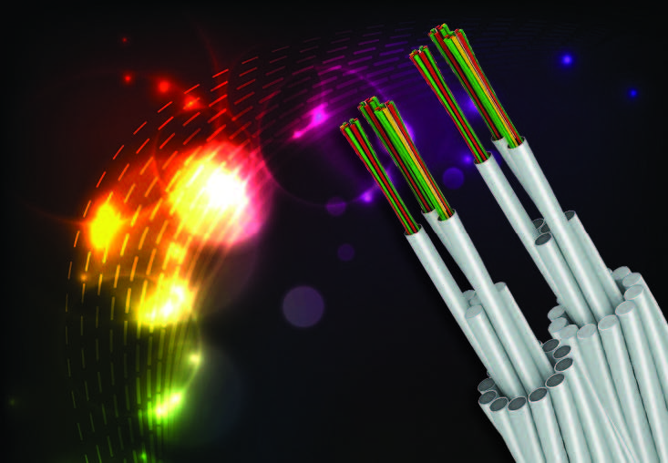
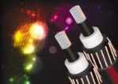
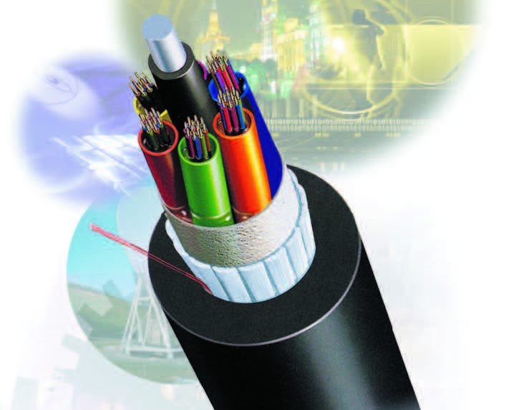
Cable
** Click image to enlarge
Standard Hard-Drawn All Aluminum Conductor
Standard Hard-Drawn All Aluminum Conductor (AAC)
Aluminum Conductor Steel Reinforced (ASCR)
Standard Aluminum Clad Steel Conductor (AWS)
Instrument Wire: The conductors shall be plain annealed Copper in accordance with BS 6360.
Bare Wire
Instrument Wire
Optical Fiber Composit Overhead Ground Wire
Typical Construction & General Characteristics
High Short Circuit Capacity Type (HC)
High Tensil Strength Type (HS)
Control Cable: Insulation shall be PVC complying with test requirements of IEC 60502 & IEC 60811. XLPE insulation is available on request.
OPGW
Control Cable
450/750V PVC Insualted Wire (450/750V IV)
MV Power Cable, Up to 30KVThe conductors shall be class 2 of plain annealed Copper or Aluminum in accordance with IEC 60228.
Insulated Wire
Power Cable
Grounding Wire (GV)
Catalog
Grounding Wire
Underground Distribution Cable (URD)
Catalog
URD
Optical Fiber, Loose Tube Jelly Filled, Loose Tube Dry Core, Ribbon Tube Dry Core, Uni Tube Dry Core, Break Out Optical Cable, Distribution Optical Cable
Catalog
Optical Fiber
** Click image to enlarge
Copper & Electric Wire, Insulated Wire, Power Cable, Control Cable, Fire Prof Cable, Elevator Cable, Telecommunications Cable.
Catalog
Electric
Hologen Free & Mud Resistant, Flame Retardant Cable : HV Power, LV Power & Control, Instrumentation & Communication, LV Earthing & Bonding Cable. Power Distribution Cable, 600V Control Cable, High Voltage Power Cable
Catalog
Marine & Offshore
Catalog

Slide 11
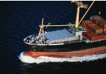
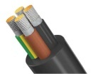
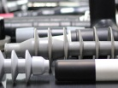
Rubber insulated electric flexible cable for mining and general use.
Catalog
Mining
• Power and Lighting Cables • Control and Signal Cables • Telephone and Instrumentation Cables
• Portable and Flexible Cords • Switchboard Wires
Catalog
Catalog
Shipboard
Wind Turbine Power and Control Cables
Catalog
Wind Turbine
Cable
Loose Tube Cable, Unit Tube Cable, ADSS, Form/Skin Insulated, Solid PE insulated.
• 2~288 Fiber Count Cable • 1~12 Fibers fer Jelly Filled Butter Tube • Custom and Composit Cables
• High Tensile Strengh Design • Excellent Optical Performance
Catalog
Cable Termination & Joint
Termination and Joint using Liquid Silicone Rubber which is excellent insulation material
Dummy Plug and Coupling Plug using Liquid Silicone Rubber
Elbow Connectors, Aluminum Lug and Sleeve using EPDM Rubber
Catalog
Copyright © 2012 by PanAmerica Supply, Inc.

Slide 12
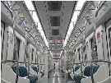
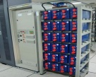
PanAmerica Supply, Inc.
Home | About Us | Customer | Linecard | Product | Sales Network | Contact Us
TR & Switchgear
Cable
Bus Duct, LED & UPS
Anti-loose Lock Nut
Bus Duct System
호-ㅖ: galvanized Steel Sheet Case Up to 750KV
Metal Enclosed, Non-Segregated Up to 35KV
Plug-in Busway Up to 1500KV
Catalog
Catalog
LED Light
LED Light for Railway Vehicle
LED Light in General
Catalog
LED
UPS
Secondary Battery for Railway Vehicle
UPS Storage Battery
Catalog
UPS
Copyright © 2012 by PanAmerica Supply, Inc.

Slide 13
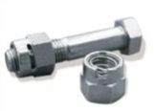
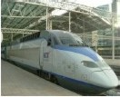
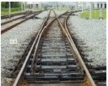
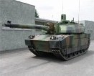
PanAmerica Supply, Inc.
Home | About Us | Customer | Linecard | Product | Sales Network | Contact Us
TR & Switchgear
Cable
Bus Duct, LED & UPS
Anti-loose Lock Nut
Anti-Loose Lock Nuts
Our technology really locks the nuts and prevents loosening, even in harsh applications with constant vibrations or quakes. And it is easy to remove using an ordinary socket.
Why don’t you take 3 minutes of your time to see for yourself in YouTube: http://www.youtube.com/watch?v=tZCcTBZuBM4
Size: M6 ~ M42 Plating: Zinc Plate, Applied Plate; Nickel Plate Anti-Corrosion Coating
Catalog
Copyright © 2012 by PanAmerica Supply, Inc.

Slide 14
PanAmerica Supply, Inc.
Home | About Us | Customer | Linecard | Product | Sales Network | Contact Us
Sales Network
Sales Area
Sales Network
Headquarters in Houston, Texas
USA Partners
Canada Partners
Northeast
Eastern Region
Southeast
Western Region
Midwest
Mexico Partners
Northern Central
Columbia Partners
Northern West
Trinidad & Tobago Partners
West Coast
Dominican Republic Partners
We are looking for regional representatives and distributors who wish to establish a long term relationship with PASI. We understand that our employees and business partners are extremely valuable to us. We look forward to working with you and achieving a successful business together. Contact us for more information if you are interested in working with us.
Copyright © 2012 by PanAmerica Supply, Inc.

Slide 15
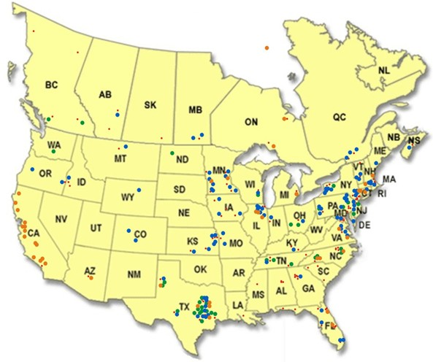
PanAmerica Supply, Inc.
Home | About Us | Customer | Linecard | Product | Sales Network | Contact Us
Sales Network
Sales Area
Sales Area
PASI is a global supplier for power industries in the Americas. Our main sales area is concentrated in the United States and Canada, supplemented by a growing network of agents in Mexico, Central America, South America, and the Caribbean Islands.
Copyright © 2012 by PanAmerica Supply, Inc.

Slide 16
PanAmerica Supply, Inc.
Home | About Us | Customer | Linecard | Product | Sales Network | Contact Us
Contact Us
Company:
Name:
E-mail:
Subject:
Message:
PanAmerica Supply, Inc.
Headquarter
21414 Provincial Blvd.
Katy, TX 77450
Phone: (281) 646-8472
(281) 646-8473
Fax: (281) 646-8474
E-mail: inquiry@panamericasupply.com
Skype: panamericasupply
Send Inquiries
Copyright © 2012 by PanAmerica Supply, Inc.

